Slide 1
Managing Development & Testing Environments in Python Softwares
@tapaswenipathak
tapaswenipathak@gmail.com

Slide 2
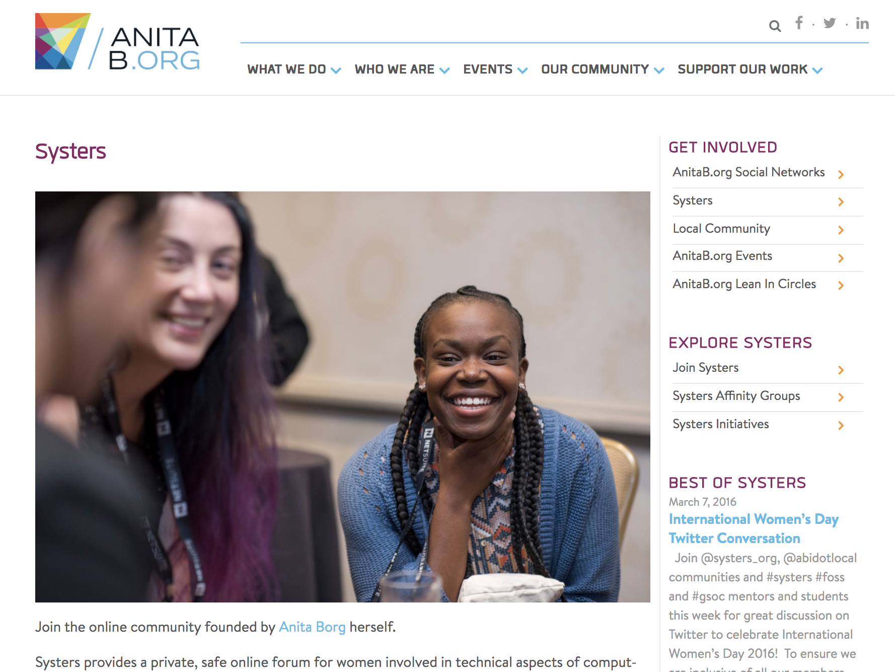
anitab.org/systers

Slide 3
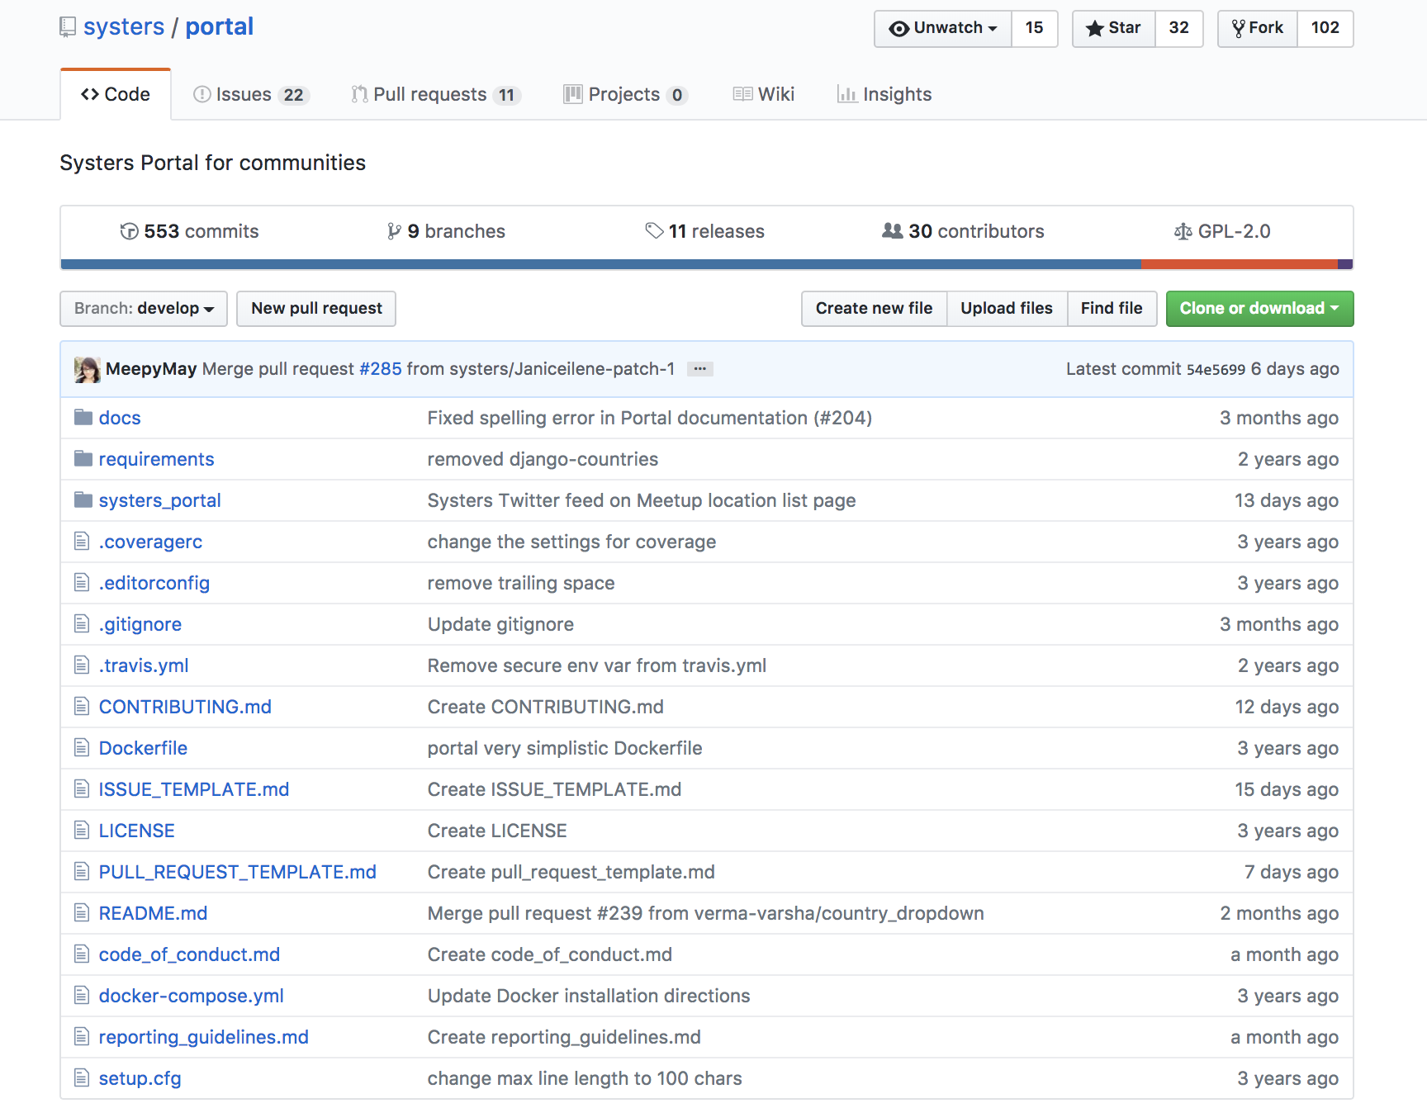
portal.systers.org

Slide 4
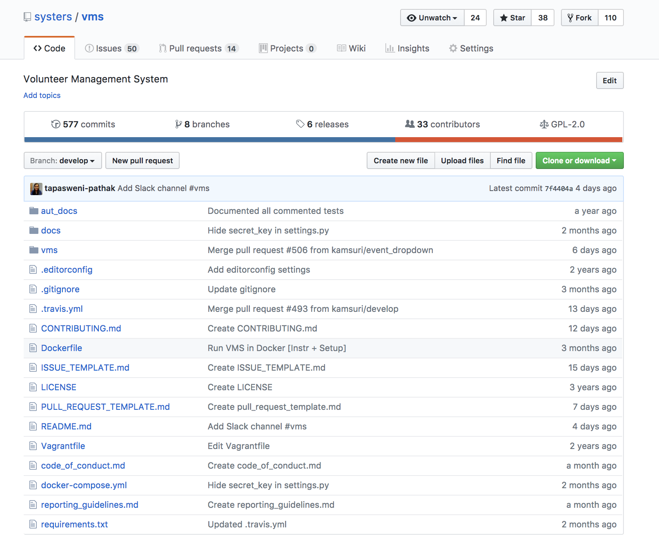

Slide 5
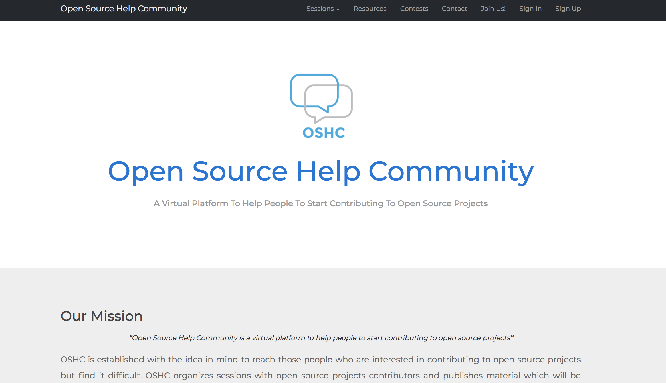
@oshelpcommunity

Slide 6
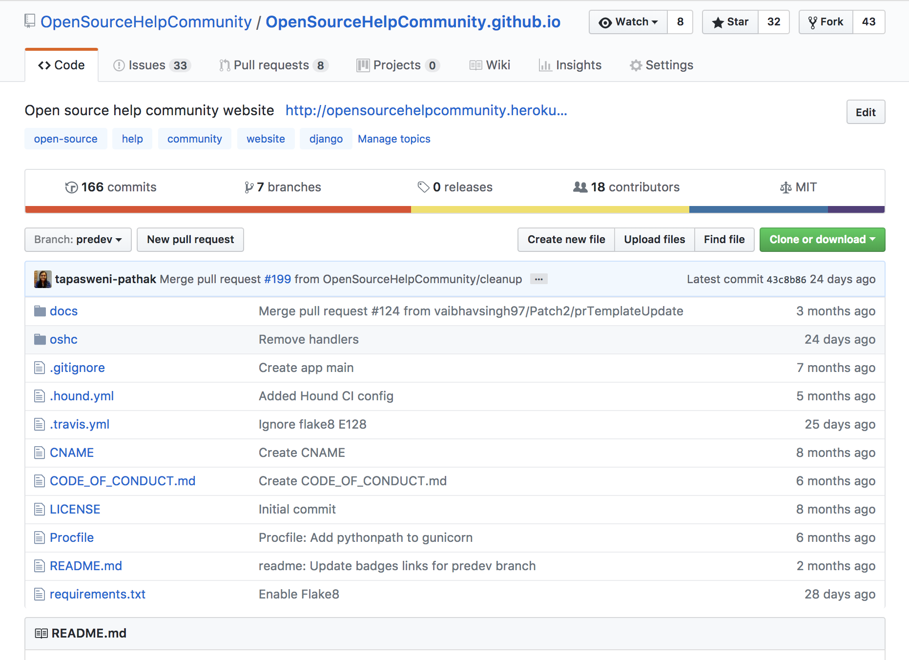

Slide 7
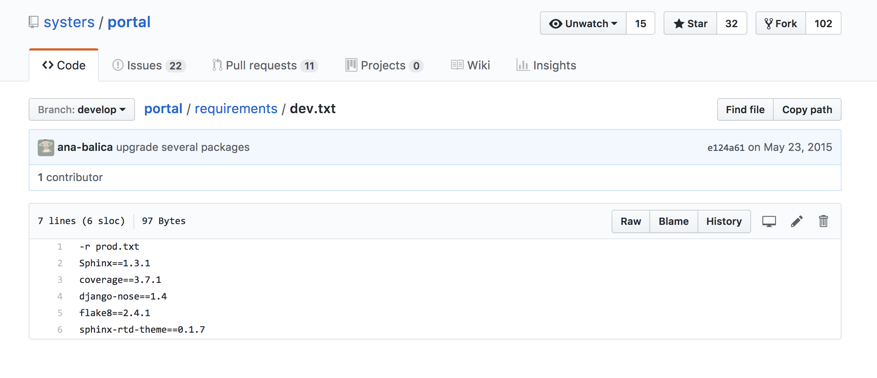

Slide 8
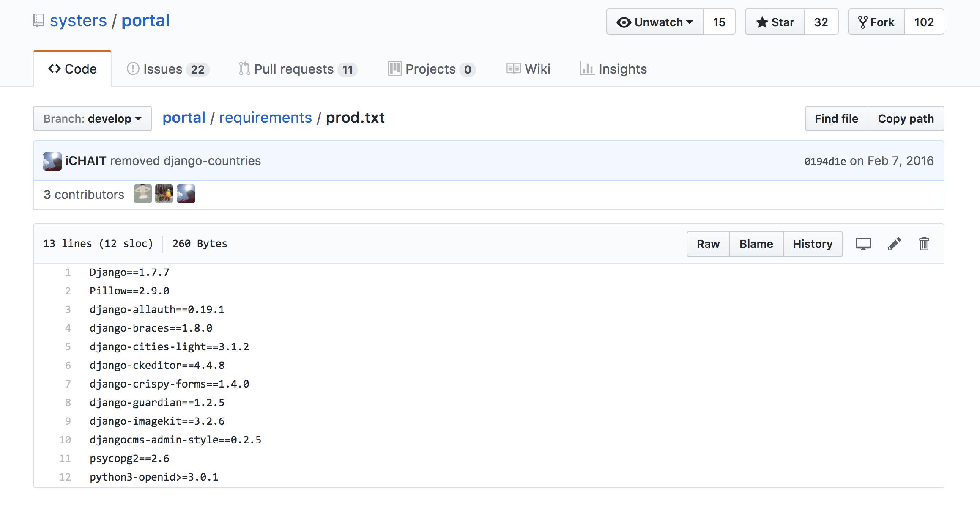

Slide 9

Python?

Slide 10
Python is everywhere!

Slide 11
Why manage?
M 1.0
M 2.0
A
B

Slide 12
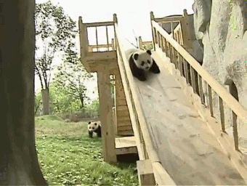

Slide 13
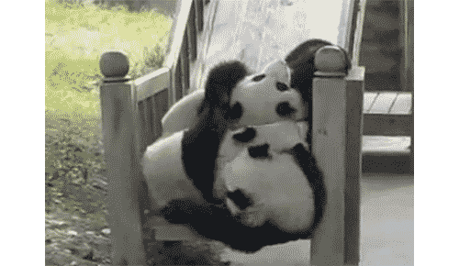

Slide 14


Slide 15
Python Packaging Ecosystem
easy_install
pip

Slide 16
virtualenv.org
sudo pip3 install virtualenv
virtualenv venv
venv/bin/python
venv/bin/pip install django

Slide 17
Lots of typing!
virtualenv venv/bin/activate

Slide 18
A lot more to it!
pip3 list
pip3 freeze
pip3 install -r requirements.txt
pip3 uninstall <package_name>
pip3 show <package_name>

Slide 19
Thank you!

